Slide 1

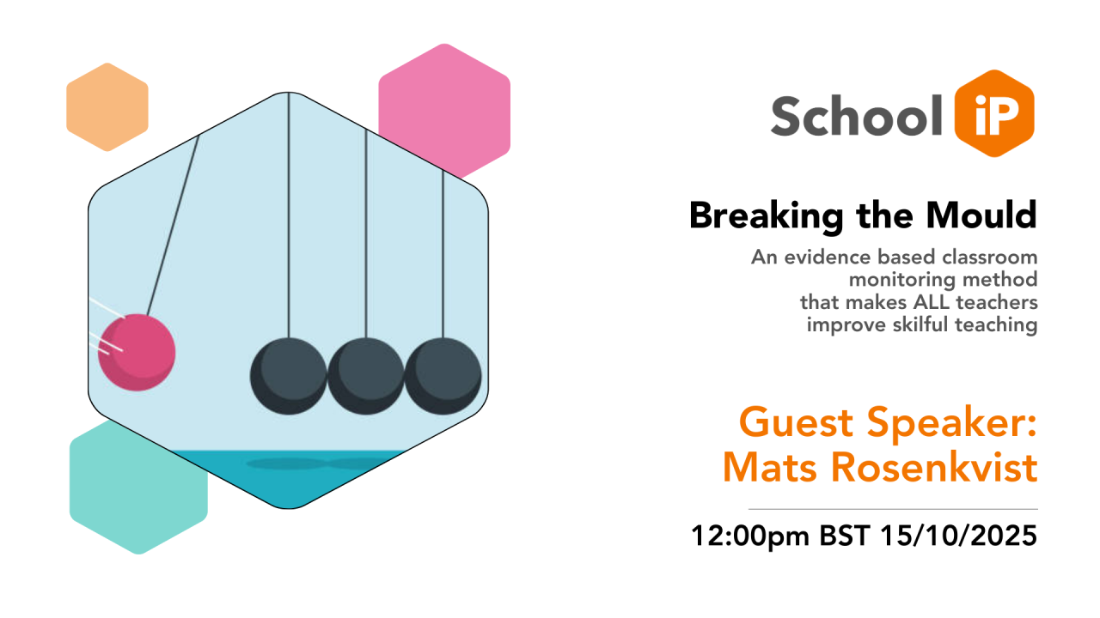
Breaking the Mould –
An evidence based
Classroom Monitoring method
that makes ALL teachers develop skilful teaching
Mats Rosenkvist
BRAVOLesson, Sweden

Slide 2
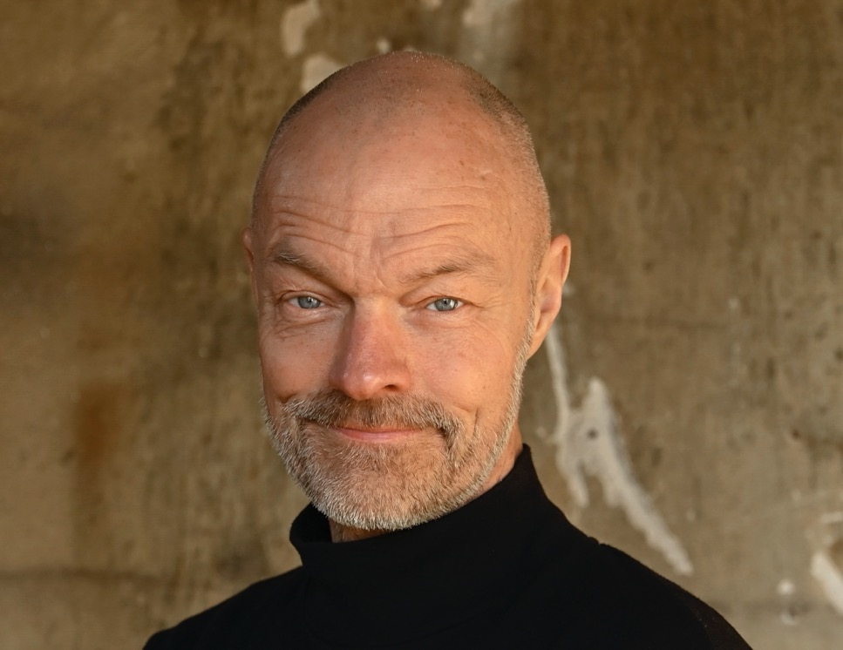
Breaking the Mould –
An evidence based
Classroom Monitoring method
that makes ALL teachers develop skilful teaching
Mats Rosenkvist
BRAVOLesson, Sweden

Slide 3

700 lessons
500 teachers
30 schools
Published June 2024
44.000 downloads

Slide 4
A cluster of experts and
researchers
More than 4.000
systematic lesson observations
Bernt Friberg
Urban Hansson
Mats Rosenkvist
University of Linköping, Sweden
Prof. Joakim Samuelsson
Associate Prof. Marcus Samuelsson
Prof. Sir George Berwick England
The London Challenge

Slide 5
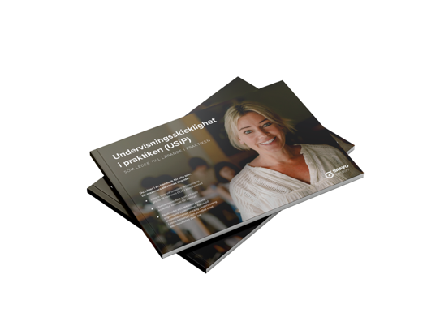


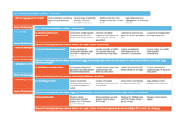

The method helps all teachers develop evidence-based, skillful teaching practices.
Data is the key to the teachers learning –
data about the quality of teaching
4. Collective reflection –
data/workshop/analysis (3 hrs)
”our teaching”
3. Individual reflection – 1 – 2 – 3 – 4
and coaching (30 min) focus on
”my teaching”
2. Systematic
lesson observations
1. Introduction/inspiration

Slide 6
Overall findings
1. Striking deficiencies in teaching in many classrooms across all schools –
teaching was generally not carried out according to evidence
2. A method resulted in that
ALL teachers improved their teaching
according to evidence
3. The method requires few resources
4. Teachers: ”Positive and concrete!”

Slide 7
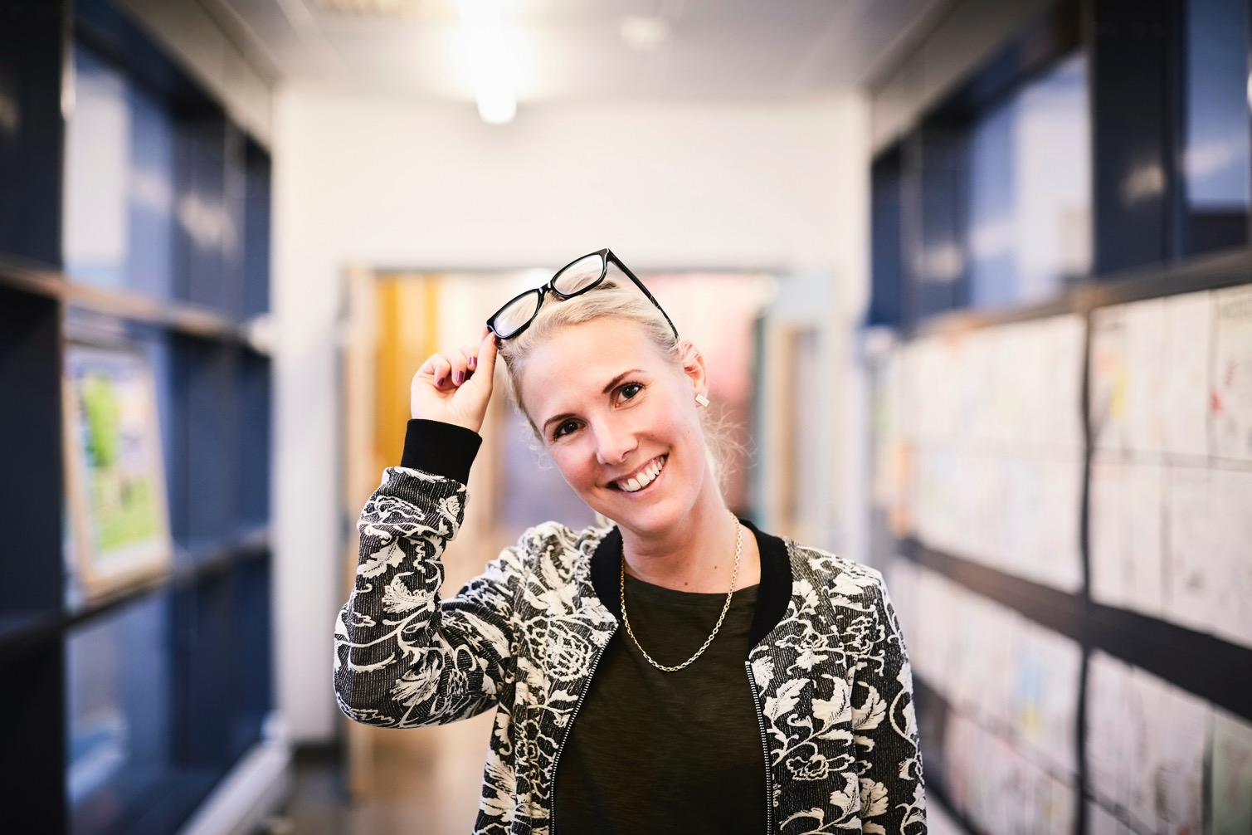
”From Assessment Anxiety to Joy of Development”
”… I haven't felt criticized, but rather noticed details and other perspectives. It has helped me stop and think about things that may have been done out of habit or without much thought...”

Slide 8
AGENDA
Skilful teaching in practice (STiP)
The method
4 success factors

Slide 9
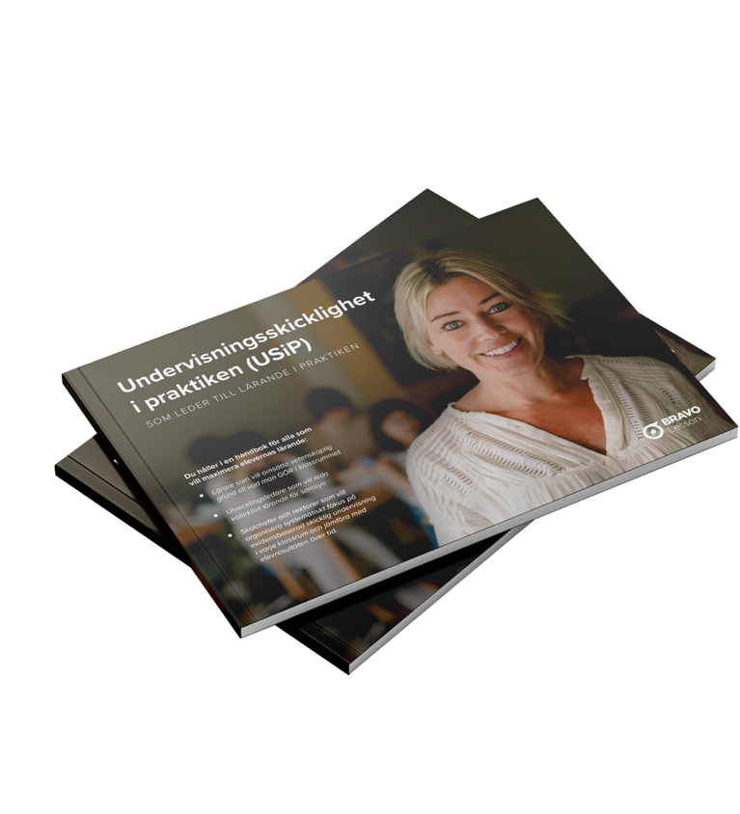
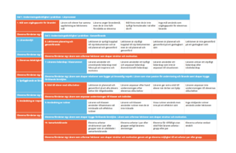




Skilful teaching in practice (STiP) in Swedish USiP
”Together we now have a common
language about teaching.”
Maria Franzén, Head Teacher Tiundaskolan

Slide 10

Training and tutoring for head teachers and key staff

Slide 11
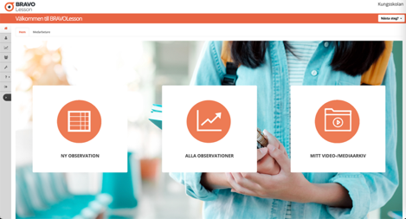
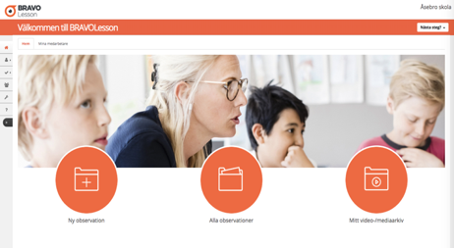

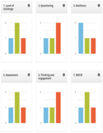

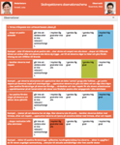


BRAVOLesson
support for
systematics
data, reflection and analysis
I samarbete med

Slide 12
Skilful teaching in practice (STiP) in Swedish USiP
”Together we now have a common
language about teaching.”
Maria Franzén, Head Teacher Tiundaskolan

Slide 13


10 dimensions of teaching –
what teachers DO that leads to learning
Recurring in research:
- over time and recently – past 25 years
- 160 researchers in 15 countries
- lead to a learning environment, motivation och learning
Part 1. Learning processes Part 2. Execution
- Goals as a starting point - Lesson planning and implementation
- Learning environment - Teacher leadership in the classroom
- Pupils' participation in learning - Support for studens with different needs
- Making learning visible - Using routines for learning lärandet
- Using response for learning - Cooperative leaening

Slide 14

Proven and developed through
4.000 systematic lesson observations
– observations started 2016
– launched 2022
– validated 2024

Slide 15
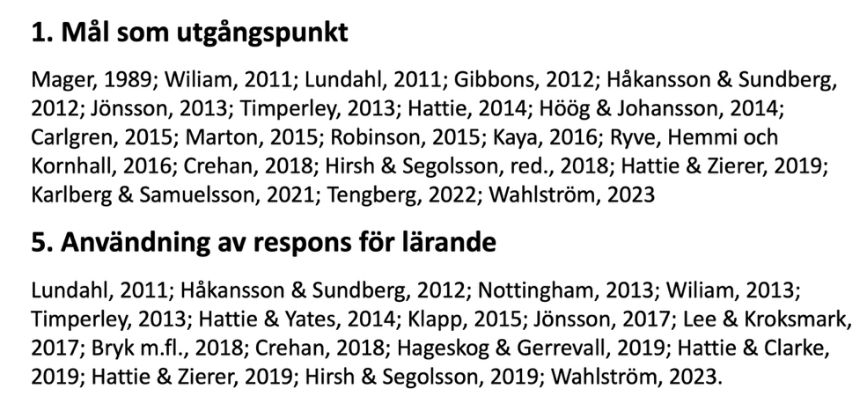
Research background – what teachers DO when pupils LEARN
160 researchers in 15 countries
Research
1. Mål som utgångspunkt
Mager, 1988; Dewey, 1997; Comenius, 1999; Marton & Booth, 2000; Arevik & Hartzell, 2007;
Hattie, 2008; Lundahl, 2011; Håkansson & Sundberg, 2012; Wiliam, 2013; Timperley, 2013;
Pihlgren, 2013a; Höög & Johansson, 2014; Lo Mun Ling, 2014; Carlgren, 2015; Robinson, 2015;
Klapp, 2015; Kaya, 2016; Körling, 2015; Ryve, Hemmi och Kornhall, 2016; Hirsh, 2017;
Jönsson, 2017; Quigley, 2017; Crehan, 2018; Blossing & Wennergren, 2019; Hirsh &
Segolsson, red., 2019; Hattie & Clarke, 2019; Hattie & Zierer, 2019; Karlberg & Samuelsson,
Red., 2021; Tengberg, 2022; Håkansson & Sundberg, 2023; Wahlström, 2023.
5. Användning av respons för lärande
Lundahl, 2011; Jönsson, 2011; Håkansson & Sundberg, 2012; Nottingham, 2013; Pihlgren, 2013;
Wiliam, 2013; Timperley, 2013; Bergstrand, Red., 2015; Hattie & Yates, 2015; Klapp, 2015; Hirsh, 2017;
Lee & Kroksmark, 2017; Quigley, 2017; Bryk m.fl., 2018; Crehan, 2018; Hirsh & Segolsson, 2019;
Hageskog & Gerrevall, 2019; Hattie & Zierer, 2019; Wahlström, 2019; Karlberg & Samuelsson, Red., 2021;
Wahlström, 2023.

Slide 16
Research background – what teachers DO when pupils LEARN
160 researchers in 15 countries
Science
1. Objectives as a starting point for learning
Mager, 1988; Dewey, 1997; Comenius, 1999; Marton & Booth, 2000; Arevik & Hartzell, 2007;
Hattie, 2008; Lundahl, 2011; Håkansson & Sundberg, 2012; Wiliam, 2013; Timperley, 2013;
Pihlgren, 2013a; Höög & Johansson, 2014; Lo Mun Ling, 2014; Carlgren, 2015; Robinson, 2015;
Klapp, 2015; Kaya, 2016; Körling, 2015; Ryve, Hemmi och Kornhall, 2016; Hirsh, 2017;
Jönsson, 2017; Quigley, 2017; Crehan, 2018; Blossing & Wennergren, 2019; Hirsh &
Segolsson, red., 2019; Hattie & Clarke, 2019; Hattie & Zierer, 2019; Karlberg & Samuelsson,
Red., 2021; Tengberg, 2022; Håkansson & Sundberg, 2023; Wahlström, 2023.
5. Using response for learning
Lundahl, 2011; Jönsson, 2011; Håkansson & Sundberg, 2012; Nottingham, 2013; Pihlgren, 2013;
Wiliam, 2013; Timperley, 2013; Bergstrand, Red., 2015; Hattie & Yates, 2015; Klapp, 2015; Hirsh, 2017;
Lee & Kroksmark, 2017; Quigley, 2017; Bryk m.fl., 2018; Crehan, 2018; Hirsh & Segolsson, 2019;
Hageskog & Gerrevall, 2019; Hattie & Zierer, 2019; Wahlström, 2019; Karlberg & Samuelsson, Red., 2021;
Wahlström, 2023.

Slide 17
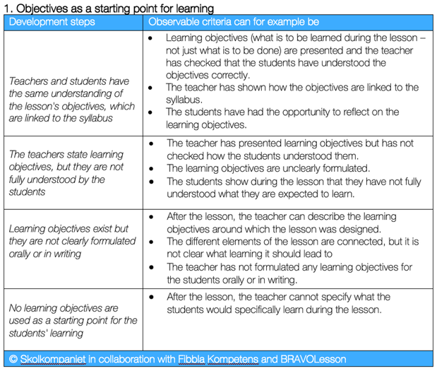
What teachers DO when pupils LEARN
Observe, discuss and develop with assessment/growth rubric – progression

Slide 18
Research background – what teachers DO when pupils LEARN
160 researchers in 15 countries
Science
1. Objectives as a starting point for learning
Mager, 1988; Dewey, 1997; Comenius, 1999; Marton & Booth, 2000; Arevik & Hartzell, 2007;
Hattie, 2008; Lundahl, 2011; Håkansson & Sundberg, 2012; Wiliam, 2013; Timperley, 2013;
Pihlgren, 2013a; Höög & Johansson, 2014; Lo Mun Ling, 2014; Carlgren, 2015; Robinson, 2015;
Klapp, 2015; Kaya, 2016; Körling, 2015; Ryve, Hemmi och Kornhall, 2016; Hirsh, 2017;
Jönsson, 2017; Quigley, 2017; Crehan, 2018; Blossing & Wennergren, 2019; Hirsh &
Segolsson, red., 2019; Hattie & Clarke, 2019; Hattie & Zierer, 2019; Karlberg & Samuelsson,
Red., 2021; Tengberg, 2022; Håkansson & Sundberg, 2023; Wahlström, 2023.
5. Using response for learning
Lundahl, 2011; Jönsson, 2011; Håkansson & Sundberg, 2012; Nottingham, 2013; Pihlgren, 2013;
Wiliam, 2013; Timperley, 2013; Bergstrand, Red., 2015; Hattie & Yates, 2015; Klapp, 2015; Hirsh, 2017;
Lee & Kroksmark, 2017; Quigley, 2017; Bryk m.fl., 2018; Crehan, 2018; Hirsh & Segolsson, 2019;
Hageskog & Gerrevall, 2019; Hattie & Zierer, 2019; Wahlström, 2019; Karlberg & Samuelsson, Red., 2021;
Wahlström, 2023.

Slide 19
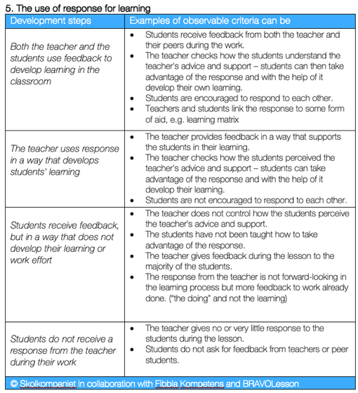
What teachers DO when pupils LEARN
Observe, discuss and develop with assessment/growth rubric – progression

Slide 20
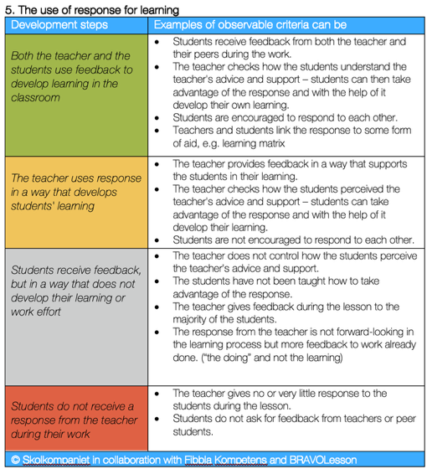
What teachers DO when pupils LEARN
Observe, discuss and develop with assessment/growth rubric – progression

Slide 21
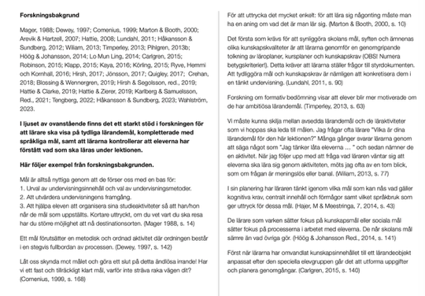


6
For every dimension there is rich content
with examples from the research background – about WHY
© Skolkompaniet och Fibbla Kompetens tillsammans med BRAVOLesson/Successful Schools Sweden AB

Slide 22
AGENDA
Skilful teaching in practice (STiP)
The method
4 success factors

Slide 23
The method
Makes ALL teachers
develop evidencebased
skillful teaching
Data is the key to the teachers learning –
data about the quality of teaching
4. Collective reflection –
data/workshop/analysis (3 hrs)
”our teaching”
3. Individual reflection – 1 – 2 – 3 – 4
and coaching (30 min) focus on
”my teaching”
2. Systematic
lesson observations
1. Introduction/inspiration

Slide 24
Collaborative learning | Collective learning
Fokus på den enskilda individens kompetensutveckling | Fokus på utveckling av skolans verksamhet i stort
Leads to improved individual knowledge and competence | Leads to improved common patterns of action in the classromms
Är beroende av kunskapen och erfarenheterna hos de lärare som för tillfället finns på arbetsplatsen. | Är beroende av att gemensamma föreställningar om den egna organisationen främjar samarbete
Underlättas av att lärarna identifierar sig med sitt yrke. | Underlättas av att lärarna identifierar sig med sin skola.
(Rönnström & Johansson, 2018, s. 403)
(Katz & Dack, 2013)

Slide 25
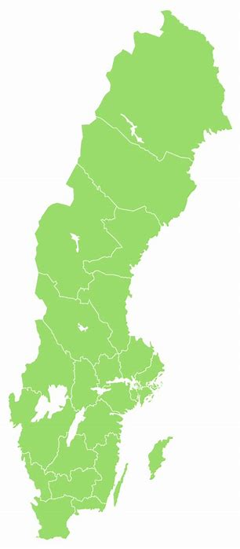
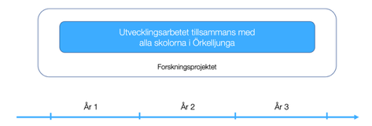
Örkelljunga LA
© Successful Schools Sweden/BRAVOLesson

Slide 26
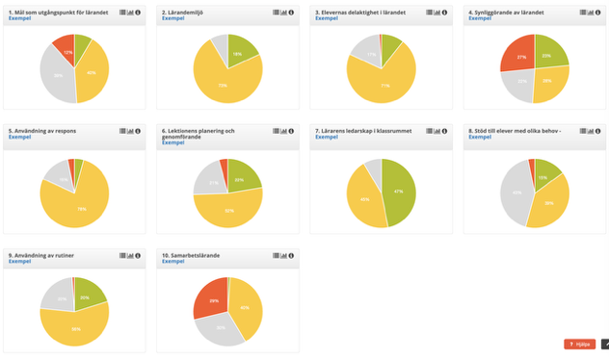
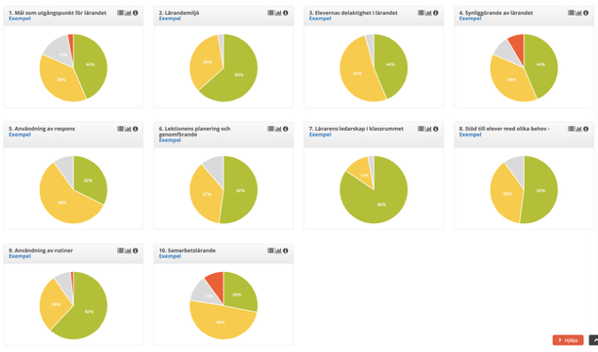
Örkelljunga LA:s all 6 primary schools HT 2024 - USiP
Utveckling av undervisningsskicklighet på vetenskaplig grund (USiP)
OBS! Alla observation 2 är ännu inte genomförda.
HT 2024 Basobservation 1 (aug – okt) HT2024 Observation 2 (okt – dec)
2 3 4 1 2 3 4
6 7 8 5 6 7 8
9 10 9 10
1. Mål som utgångspunkt för lärande
2. Lärandemiljö
3. Elevernas delaktighet i lärandet
4. Synliggörande av lärandet
5. Användning av respons för lärande
6. Lektionens planering och genomförande
7. Lärarens ledarskap i klassrummet
8. Stöd till elever med olika behov
9. Användning av rutiner
10. Samarbetslärande

Slide 27
Trolle Ljungby skola
© Successful Schools Sweden/BRAVOLesson

Slide 28
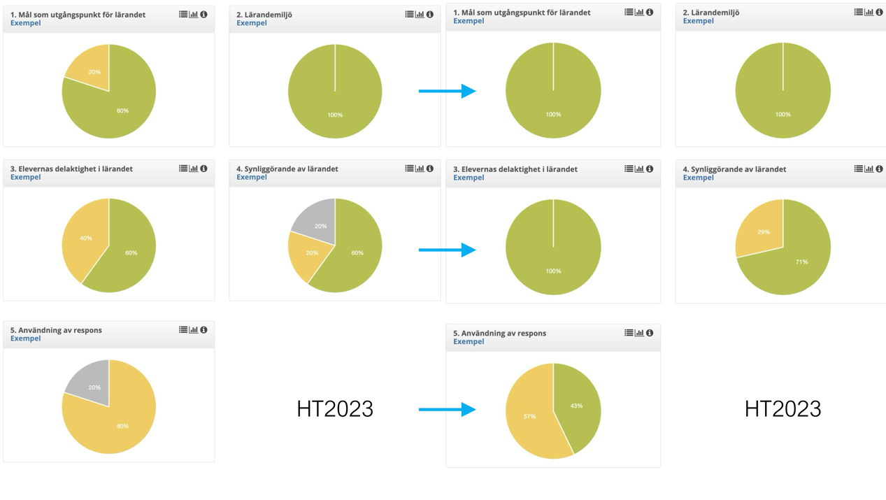

After term 4
After term 6
© Successful Schools Sweden/BRAVOLesson

Slide 29
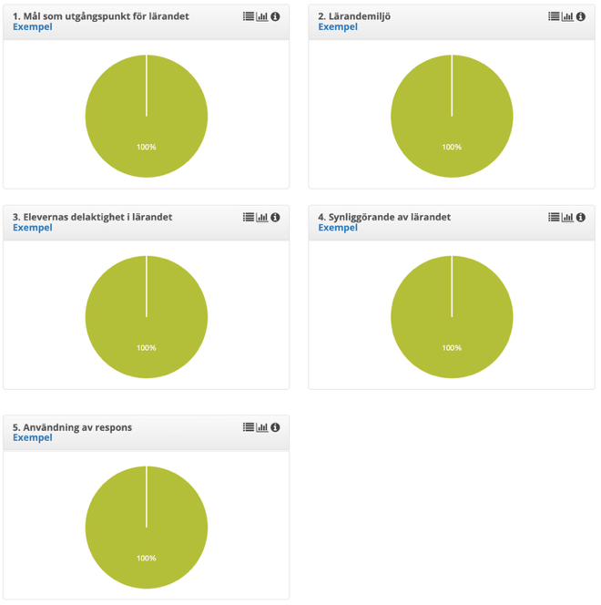
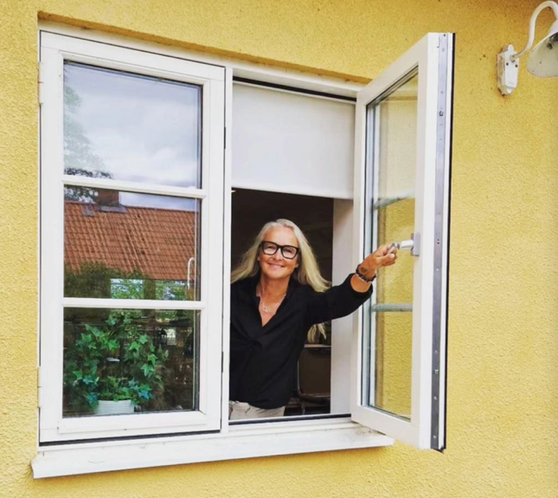
HT 2024
After term 7 Head Teacher Jessika Müller
© Successful Schools Sweden/BRAVOLesson

Slide 30
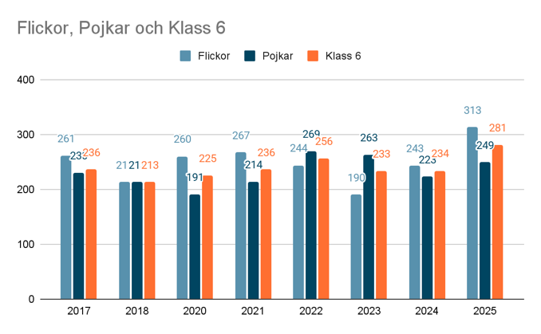
Pupil outcome Trolle Ljungby skola

Slide 31
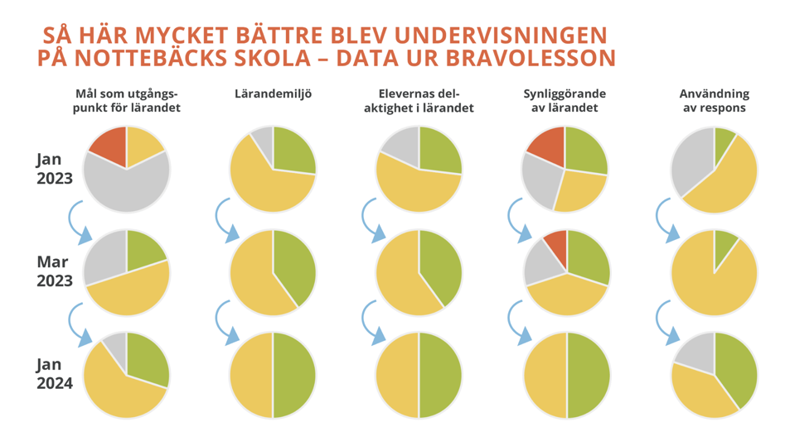
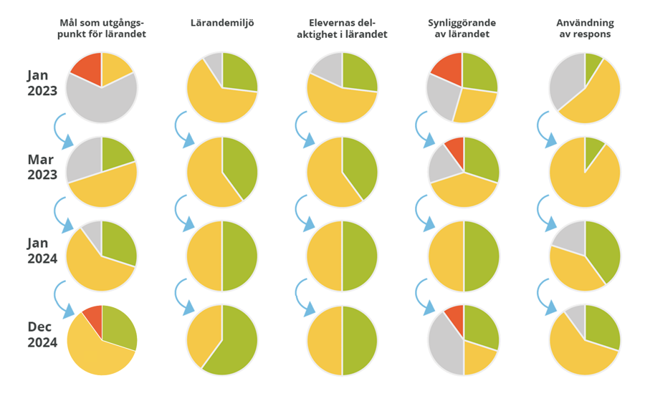
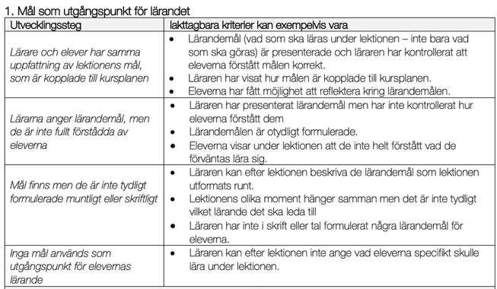
Teacher discussion: ”What do WE need to DO in the classroom to improve from yellow to green?”

Slide 32
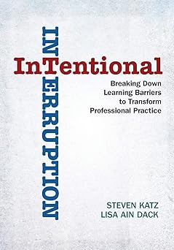
Definition of
Transforming Professional Practice
= lasting improvements in ways of
thinking and doing in the classroom
= a prerequisite for higher knowledge results
Data is challenging and changing
teachers’ beliefs and perceptions.
leads to new insights – in other words,
ways of thinking and doing in the classroom
Källa: Katz & Dack, 2013
© Successful Schools Sweden/BRAVOLesson

Slide 33
AGENDA
Skilful teaching in practice (STiP)
The method
4 success factors

Slide 34



Success factor 1
Focus on teaching that research has proven to provide study peace, motivation and learning

Slide 35

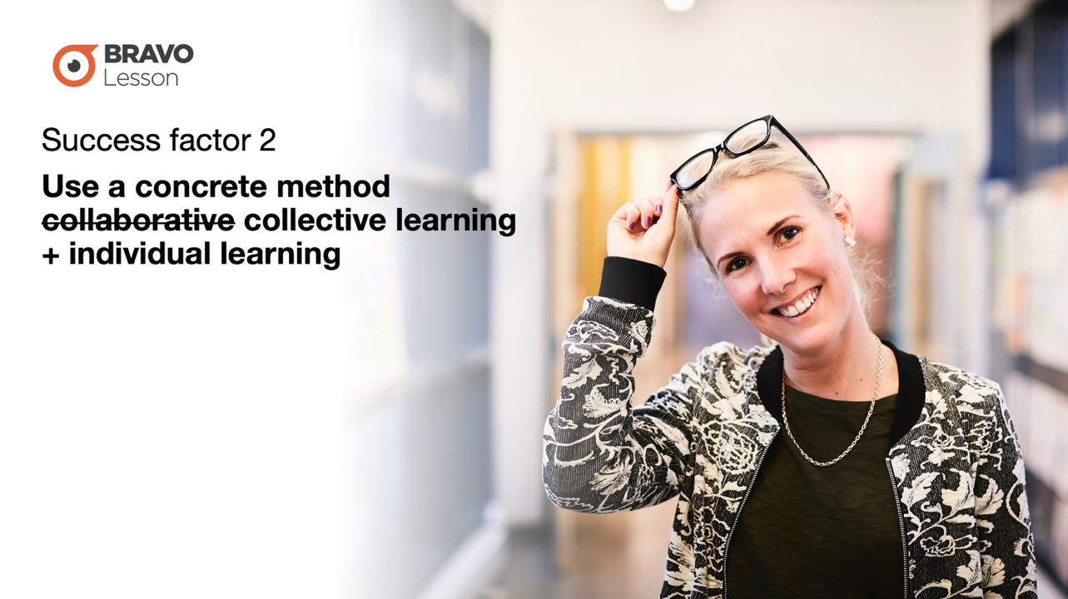
Success factor 2
Use a concrete method
collaborative collective learning
+ individual learning

Slide 36
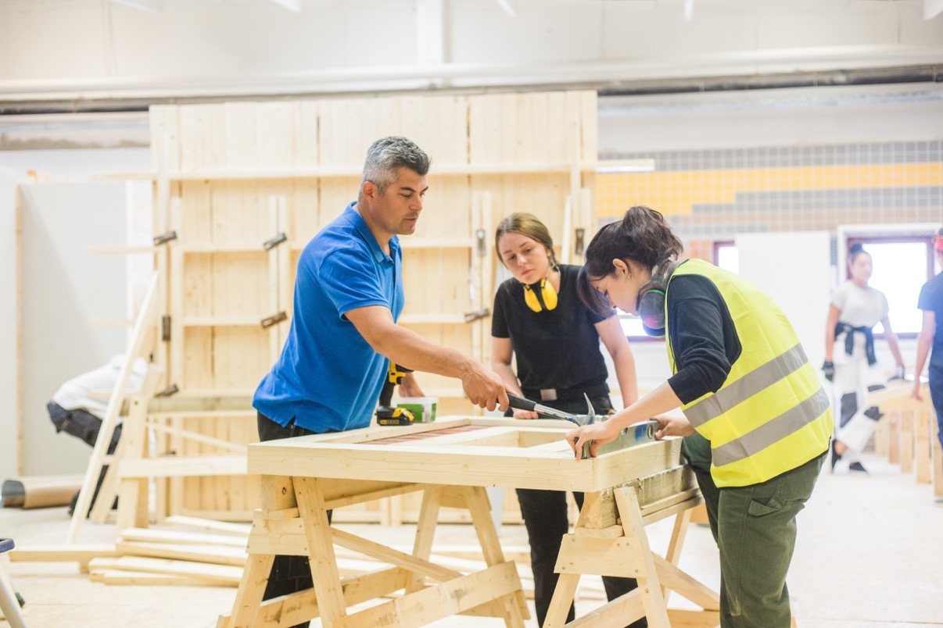

Success factor 3
Go from feeling to knowing – collect data through systematic lesson observations

Slide 37
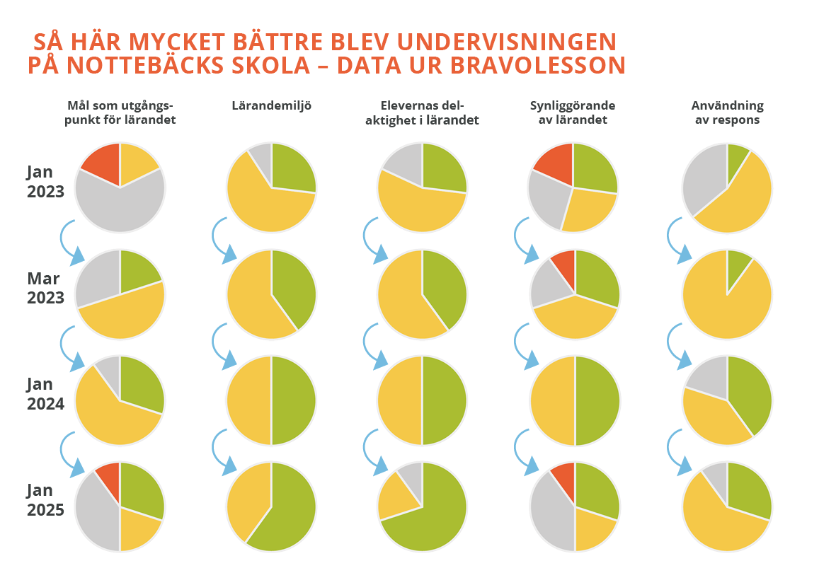
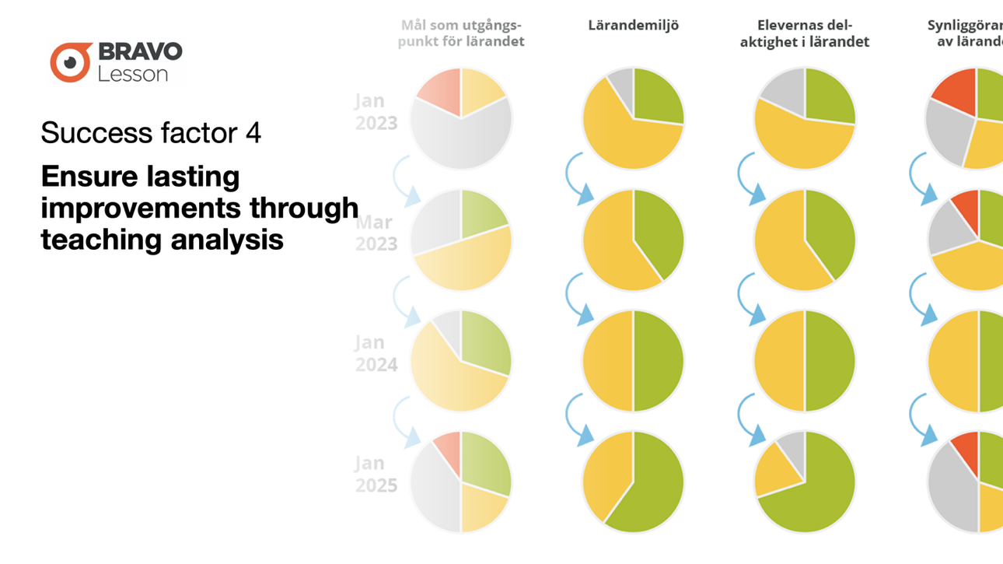
Success factor 4
Ensure lasting improvements through
teaching analysis

Slide 38


Eng. Skillful teaching in every classroom

