Slide 1

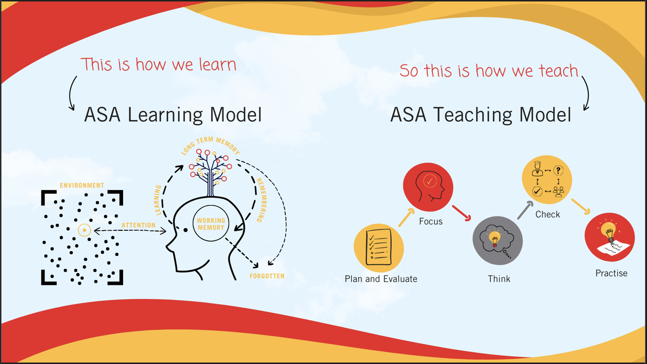
Improving Teaching & Learning
From Strategy to Classroom Practice
Liam Wilkinson
Associate Principal

Slide 2

The Challenge We Faced
Staff at different starting points
Inconsistent evaluation of teaching quality
Limited visibility of whole-school progress

Slide 3
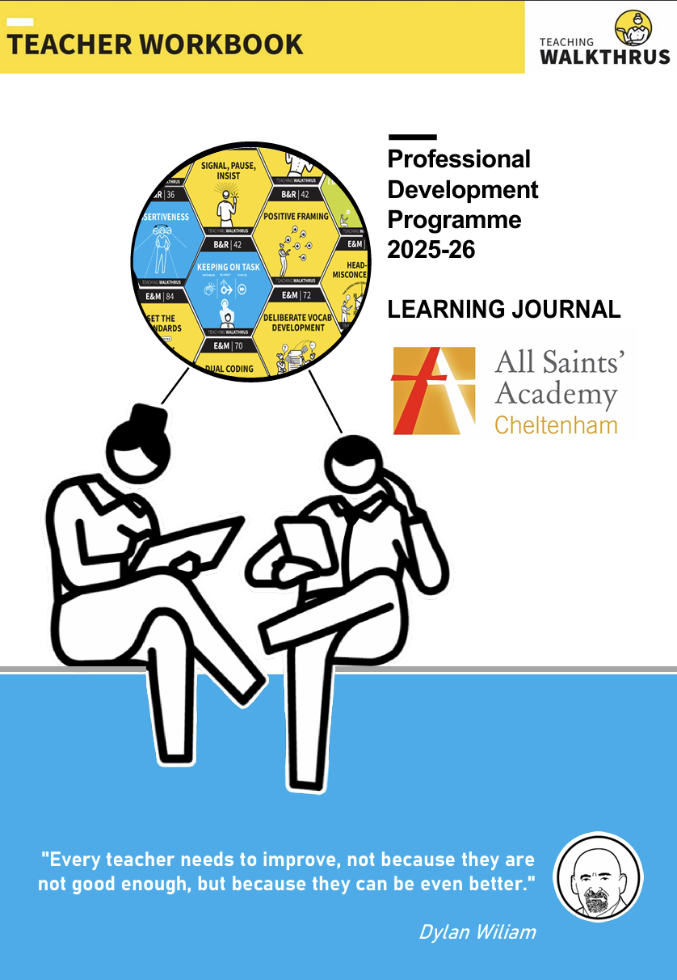
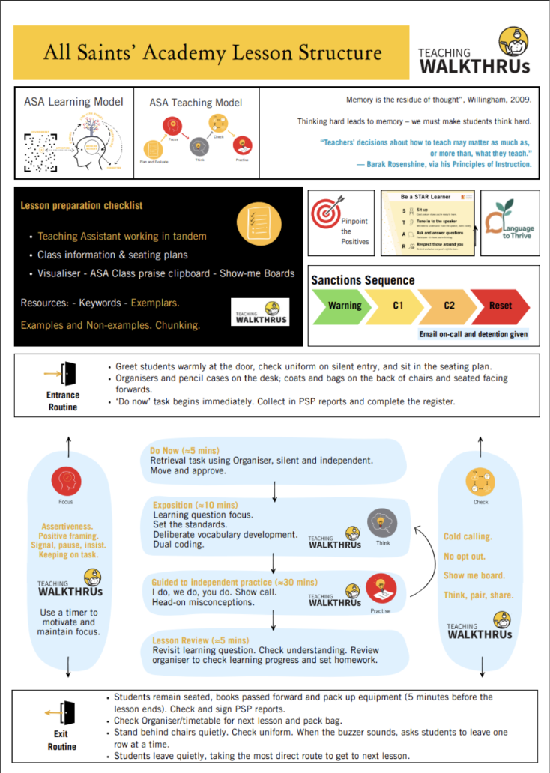
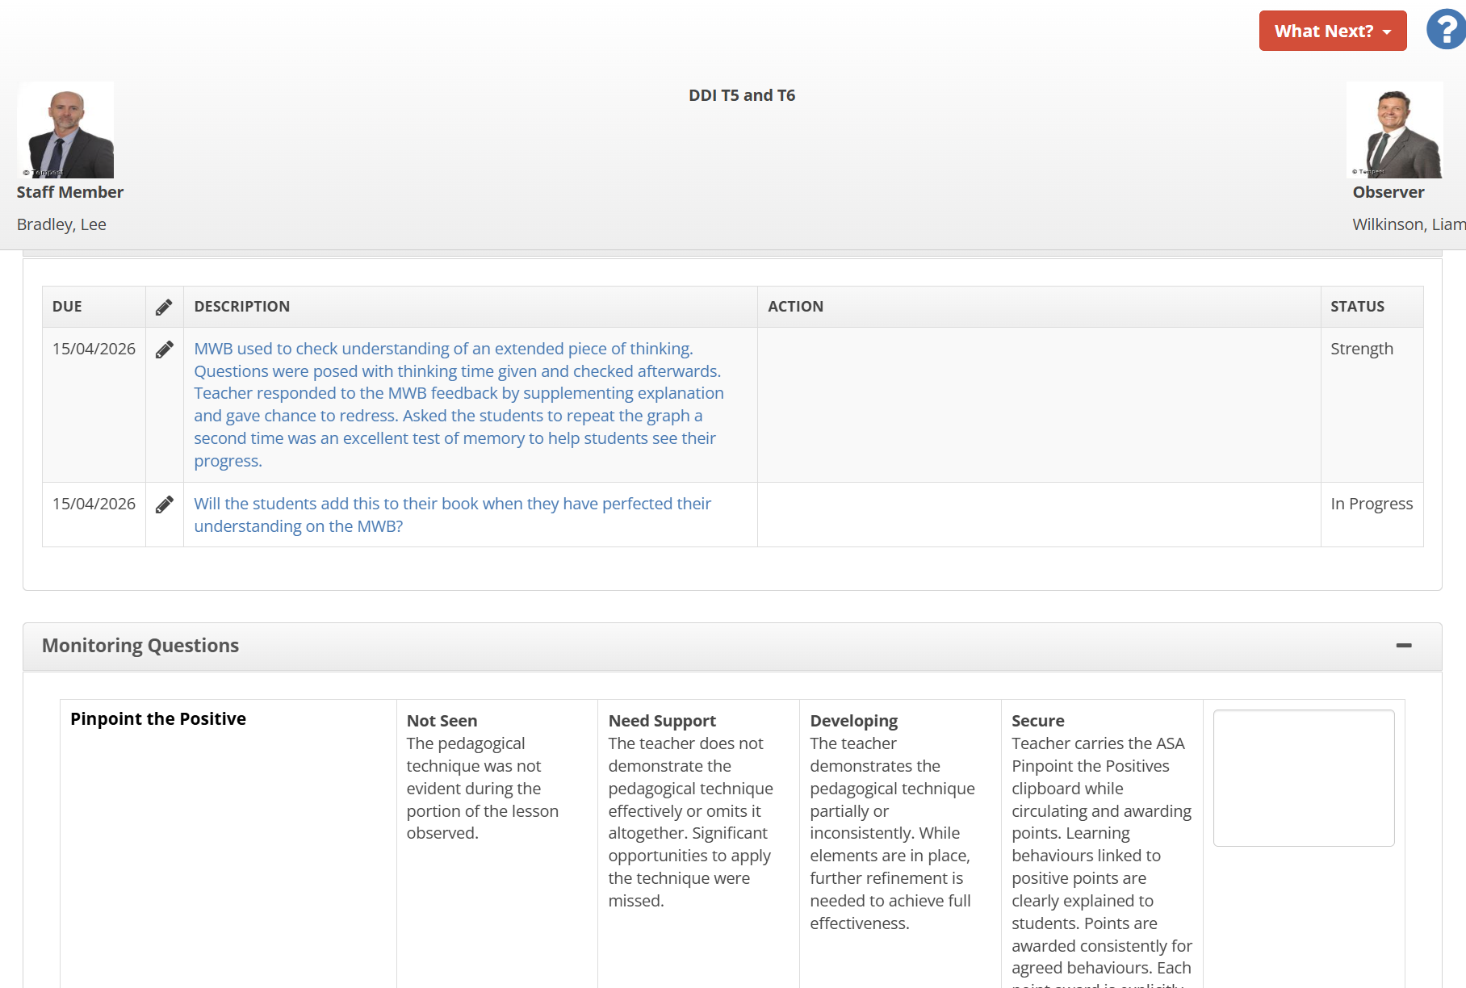
Our Approach to Improvement
Research-informed teaching model
Ongoing, responsive training
Regular classroom monitoring
Continuous refinement

Slide 4
What Was Missing?
Connecting strategy, practice, and development
Consistency across classrooms
Clear, trackable view of progress

Slide 5
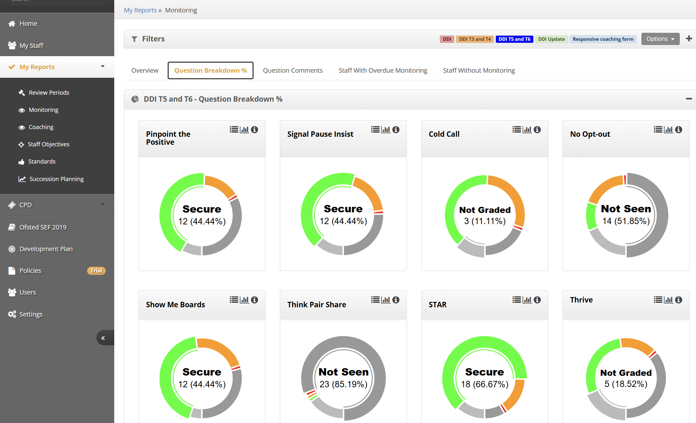
How School IP Supported Our Work
Support → Consistency & Accountability → Insight
Support: Coaching records, structured dialogue
Consistency: Drop-ins, clear criteria, appraisal alignment
Insight: Monitoring reports, trends over time

Slide 6
What Changed?
Greater visibility of teaching quality
Stronger link between PD, appraisal and priorities
Staff progress tracked over time
Reduced workload through automation

Slide 7
What We’ve Learned
Change has been gradual
Started with appraisal, evolved over time
Ongoing refinement has been key
Further development still needed

Slide 8
Key Takeaway
Connecting strategy, classroom practice, and professional development
is key to improving teaching quality

