Slide 1


The Governance Reset:
Aligning Governance Systems with People, Processes and Places
Rita Patel, Head of Governance

Slide 2
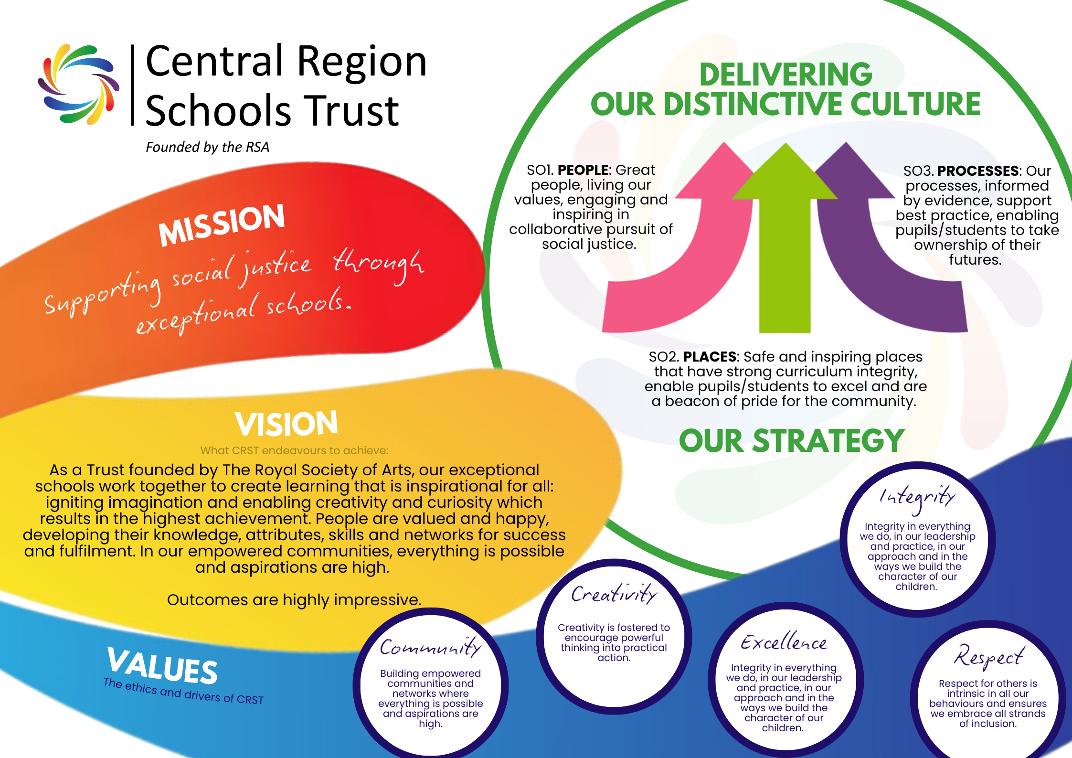
Notes:
Mission
Supporting social justice through exceptional schools. We believe education should create equity, opportunity and lasting life chances for every child regardless of background.
Vision
Inspired by our RSA foundations, we create schools that:
Inspire curiosity, character and high achievement
Value people, ensuring children and staff feel respected and supported
Act as joyful, creative communities where every child believes anything is possible
This approach works — our outcomes consistently reflect it.
Values
Our values shape culture, behaviour and decision‑making across the Trust and are evident in our governance practice
Community – Strong, generous communities that support every child
Creativity – Curiosity, imagination and innovation in action
Integrity – Doing what is right, with honesty and fairness
Excellence – High expectations and continual improvement
Respect – Inclusive cultures built on kindness and dignity
These are not statements — they are how we work for children, every day.

Slide 3
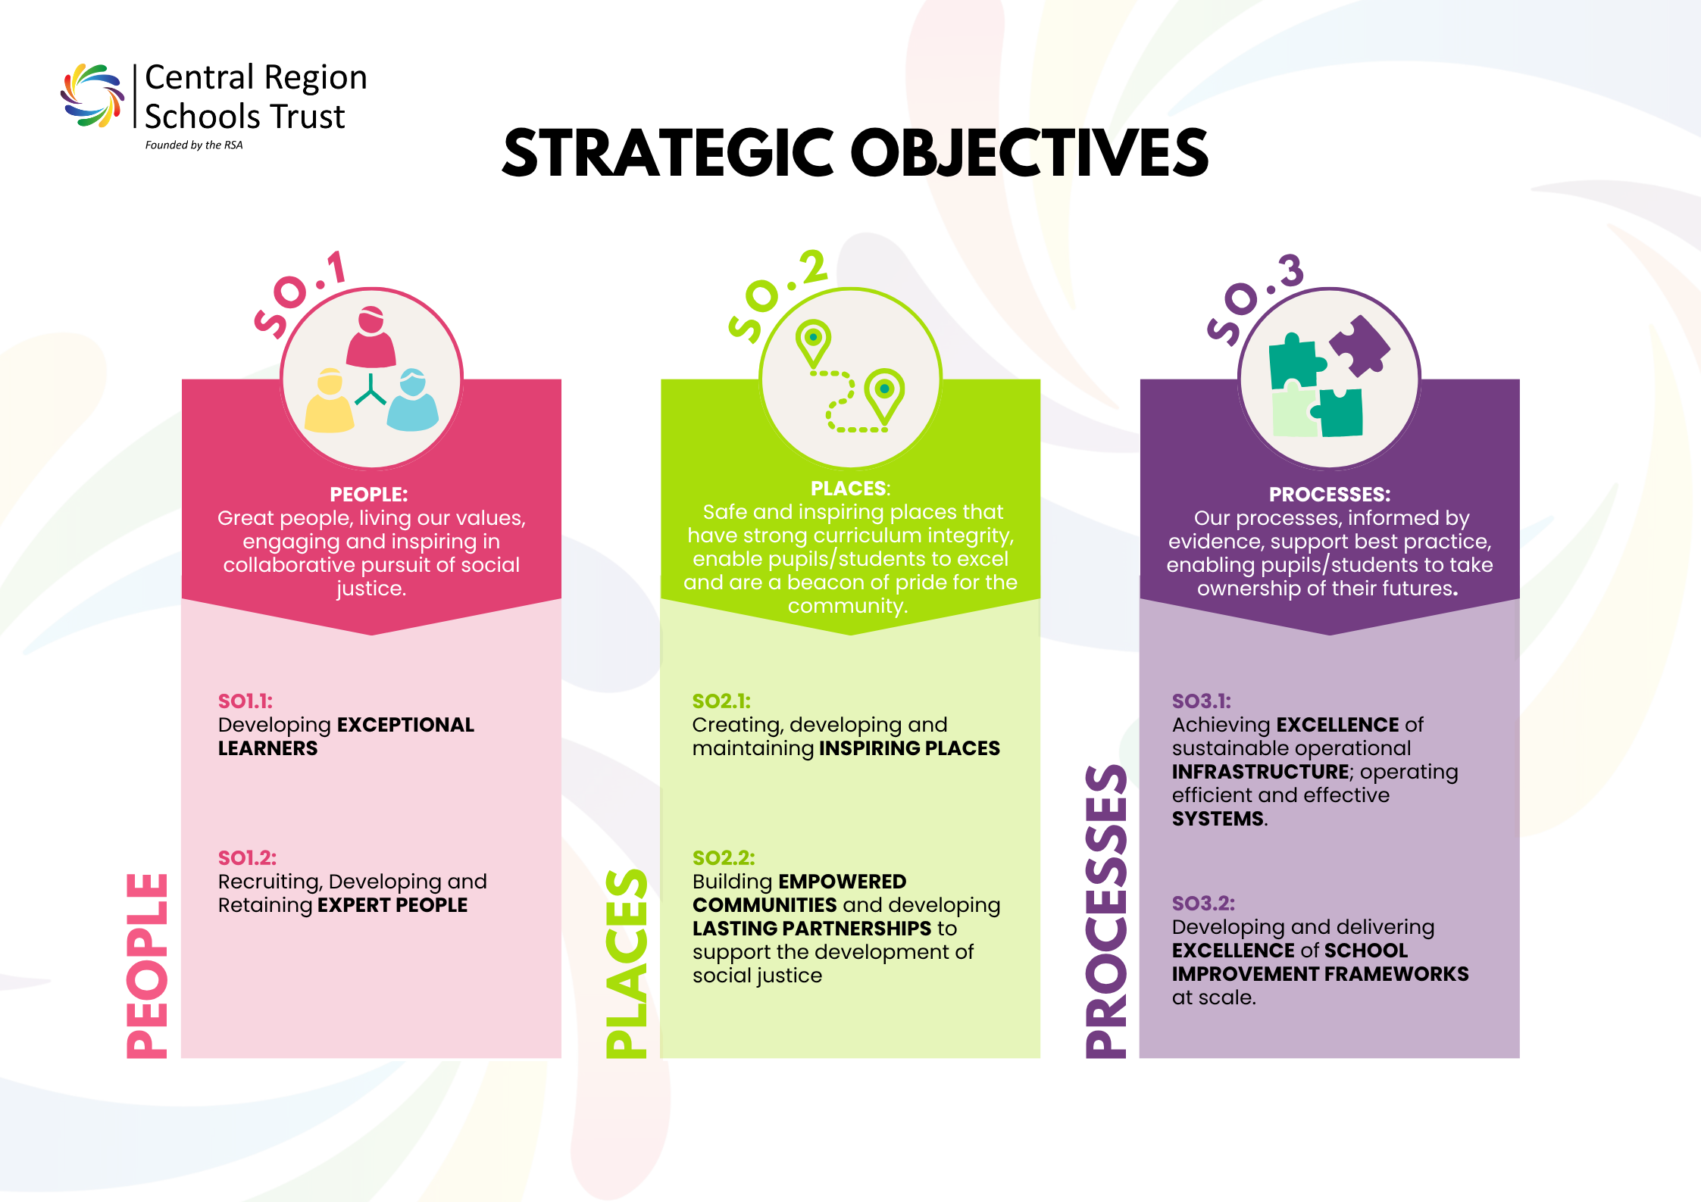
Notes:
Our Distinctive Culture
“We describe our culture through three pillars: People, Places and Processes.
People – We want great people who live our values, engage positively, and lead a strong, collaborative pursuit of social justice.
Places – Our schools should be safe, inspiring environments where excellent curriculum and enrichment enable children to thrive and communities feel proud.
Processes – Our systems are evidence‑informed, supportive and transparent, empowering everyone to take ownership of their work.”
“These three pillars – People, Places and Processes – shape how we deliver our strategy every day.”

Slide 4
The Governance Reset
Aligning Governance Systems with People, Processes and Places
Governance is a statutory accountability system
Weak governance design creates unequal pupil experiences
Clarity, consistency and access are now core governance duties
Notes:
The Governance Reset: Aligning Governance Systems with People, Processes and Places
Governance, for me, sits where accountability, trust and the protection of children meet.
Over the last few years, statutory expectations on trusts have become much clearer and much sharper — safeguarding, complaints, exclusions, admissions, standards. None of that is optional anymore, and nor should it be.
What hasn’t always kept pace are the systems that turn those expectations into day‑to‑day reality. Too often, governance relies on individual knowledge, goodwill or historic practice rather than deliberate design. So it could be the governance professional and Principal are aware of nuances of the local board and practice however as MAT's grow we need to focus on sclabililty and fairness and equity for our children, families and colleagues
When I talk about a governance reset, I’m not talking about adding complexity or inventing something new. I’m talking about realignment — with how people actually work, how processes really operate, and where governance knowledge truly lives. At CRST, that reframing has fundamentally changed how we think about governance and its role.

Slide 5
Why Governance Needs a Reset
When systems are unclear, justice becomes uneven
Statutory expectations are clear, but pathways vary
Inconsistency advantages confidence and social capital
Informal handling embeds bias and disadvantage
Complexity weakens Trust Board assurance
(DfE complaints, exclusions, admissions and safeguarding guidance)
Notes:
SLIDE 2 — Why Governance Needs a Reset
When systems are unclear, justice becomes uneven
Speaker notes:
Good governance is usually quiet. It’s predictable, it’s fair, and when it’s working well, it almost goes unnoticed.
But when governance systems are unclear or inconsistently applied, the impact is never neutral. The children and families most affected are those with the least power to navigate uncertainty — families facing disadvantage, language barriers, SEND complexity, or already fragile relationships with institutions.
Informal handling, reliance on confidence or familiarity, or a sense of “this is how we’ve always done it” doesn’t create flexibility — it creates inequality. It advantages social capital, not justice.
So a governance reset isn’t just technical improvement. It’s an equity intervention. It’s about ensuring that rights, protections and processes apply consistently to every child, not just those best placed to demand them.

Slide 6
Governance Is A Child Protection System
Governance exists to ensure fairness, not merely compliance
Governance systems must demonstrably ensure:
Lawful and timely decision making
Procedural fairness and staged escalation
Consistency across settings
Clear, inspectable evidence trails
Notes:
SLIDE 3 — Governance Is a Child‑Protection System
Governance exists to ensure fairness, not merely compliance
Speaker notes:
The DfE guidance we work within — on complaints, exclusions, safeguarding and admissions — exists for a reason. It exists because historic failures caused harm to children, often repeatedly and without challenge.
Governance is the mechanism through which fairness is enacted. It ensures decisions are lawful, timely, evidence‑based and reviewable.
When governance systems are weak, poor decisions are harder to challenge, escalation becomes inconsistent, and children experience very different outcomes for very similar issues.
That’s why I’m clear: governance is part of our safeguarding infrastructure. It’s not separate from child protection — it’s one of the ways protection happens early, quietly and before harm escalates.

Slide 7
The Reset Lens: People, Processes, Places
People
Governors clear on statutory boundaries
Governance Professionals are positioned as guardians of due process and enabling system coherence
Processes
Trust wide pathways aligned to DfE guidance
Clear stages, rights and timelines
Proportionate but consistently applied
Places
One authoritative governance “home”
Live guidance, not archived paperwork
Transparent access for schools and families
Notes:
SLIDE 4 — The Reset Lens: People, Processes, Places
How governance design delivers equity
Speaker notes:
This three‑part lens — People, Processes and Places — really changed how we approached governance at CRST.
People: Governors and governance professionals are statutory office‑holders. Role clarity matters — not just for effectiveness, but to protect individuals from inappropriate pressure, blurred boundaries or unconscious bias.
Processes: Clear, trust‑wide pathways matter most in high‑stakes situations — exclusions, complaints, safeguarding — where inconsistency causes real harm. Rights, timescales and decision‑making standards must be understood and applied consistently.
Places: Governance has to live somewhere authoritative and visible. When knowledge sits in inboxes or individual heads of people, transparency collapses — and trust with it.Well‑designed governance isn’t bureaucratic. It’s a deliberate act of justice

Slide 8
Before and After Systems Comparisons
Before
Guidance spread across emails, documents and individual knowledge
Inconsistent handling of complaints, exclusions and admissions
Informal advice routes reliant on confidence or relationships
Variable understanding of statutory roles and boundaries
Policy compliance hard to evidence and assure
Board assurance based on reassurance rather than systems
After
A single, live governance portal as the authoritative reference point
Trust‑wide statutory pathways applied consistently across schools
A clear helpdesk and escalation mechanism for governance advice
Structured induction, training and compliance cycles
Centralised policy management and statutory website oversight
Stronger assurance through clear evidence trails and transparency
Notes:
SGovernance Systems Being Embedded Across the Trust
Moving from individual knowledge to trust‑wide infrastructure
A single, authoritative Governance Portal One trust‑wide source of live governance guidance, replacing fragmented documents, inbox dependency and informal advice [Governance | SharePoint]
Standardised statutory pathways for high‑risk areas Embedded systems for complaints, exclusions & suspensions, admissions, safeguarding and policy compliance, aligned directly to DfE expectations [Governance | SharePoint]
Formal governance helpdesk and escalation route A clear mechanism for schools to access timely governance advice, reducing informal handling and inconsistent practice [Governance | SharePoint]
Defined compliance cycles and termly governance tasks Systematised expectations for LGBs, improving consistency, assurance and oversight [Governance | SharePoint]
Structured governor recruitment and induction framework A consistent approach to onboarding, statutory understanding and role clarity across all boards [Governance | SharePoint]
Policy management and website compliance framework Clear ownership, assurance and visibility of statutory policies, reducing risk and inspection vulnerability [Governance | SharePoint]
Transparent feedback and continuous improvement loop Built‑in mechanisms to review how governance systems are working in practice and refine them over time [Governance | SharePoint]
What This Changes in Practice
Governance advice is accessible, consistent and inspectable
Decision‑making relies on systems, not confidence or relationships
Boards and leaders operate within clear statutory guardrails
Trust assurance is strengthened through evidence, not reassurance

Slide 9
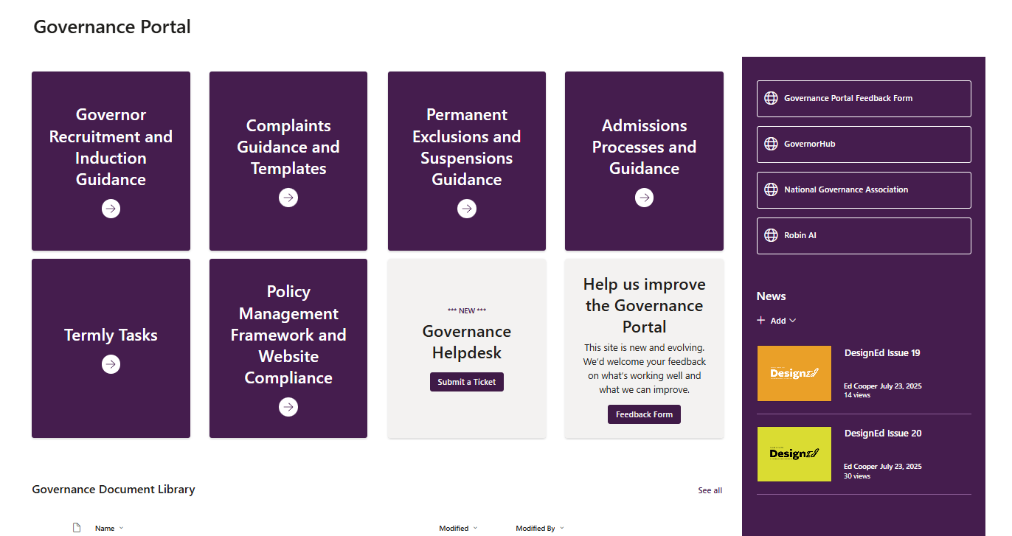
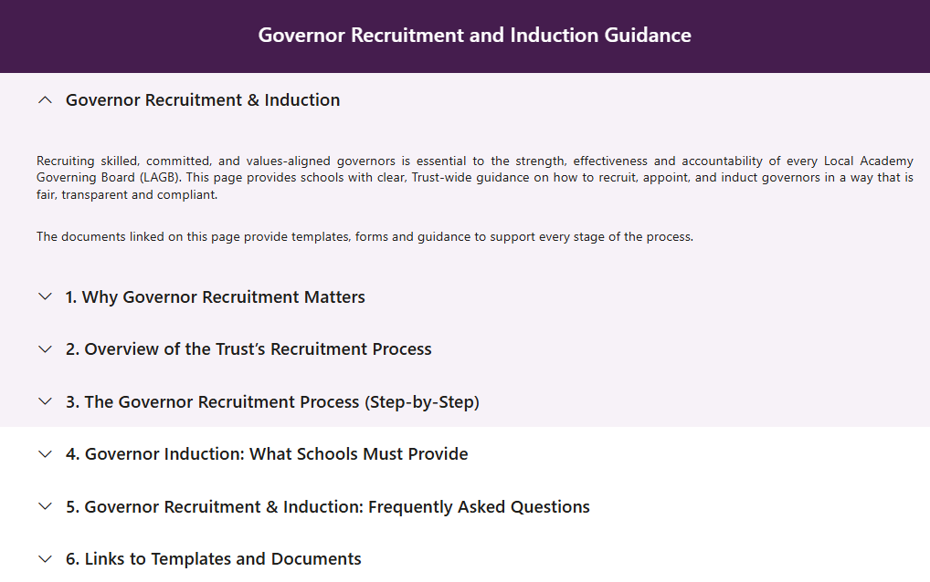
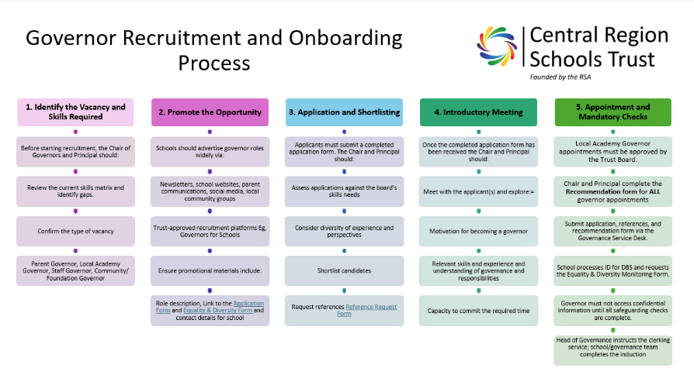
Governance Portal
Notes:
Governance Systems Being Embedded Across the Trust
Moving from individual knowledge to trust‑wide infrastructure
A single, authoritative Governance Portal One trust‑wide source of live governance guidance, replacing fragmented documents, inbox dependency and informal advice [Governance | SharePoint]
Standardised statutory pathways for high‑risk areas Embedded systems for complaints, exclusions & suspensions, admissions, safeguarding and policy compliance, aligned directly to DfE expectations [Governance | SharePoint]
Formal governance helpdesk and escalation route A clear mechanism for schools to access timely governance advice, reducing informal handling and inconsistent practice [Governance | SharePoint]
Defined compliance cycles and termly governance tasks Systematised expectations for LGBs, improving consistency, assurance and oversight [Governance | SharePoint]
Structured governor recruitment and induction framework A consistent approach to onboarding, statutory understanding and role clarity across all boards [Governance | SharePoint]
Policy management and website compliance framework Clear ownership, assurance and visibility of statutory policies, reducing risk and inspection vulnerability [Governance | SharePoint]
Transparent feedback and continuous improvement loop Built‑in mechanisms to review how governance systems are working in practice and refine them over time [Governance | SharePoint]
What This Changes in Practice
Governance advice is accessible, consistent and inspectable
Decision‑making relies on systems, not confidence or relationships
Boards and leaders operate within clear statutory guardrails
Trust assurance is strengthened through evidence, not reassurance

Slide 10
Impact of this?
System clarity improves lived experience
Earlier and fairer complaint resolution
Clearer scrutiny of exclusion decisions
Stronger safeguarding oversight
Reduced escalation and breakdowns
Greater confidence in governance outcomes
Notes:
SLIDE 5 — What Changed at CRST
System clarity improves lived experience
Children rarely see governance directly — however the management and effectiveness of governance can affect them directly.
Clearer complaints processes mean issues are resolved earlier and relationships are far more likely to be repaired than fractured.
Consistent, well‑evidenced scrutiny of exclusion decisions improves decision‑making and reduces unnecessary escalation.
Visible, owned safeguarding oversight means concerns are acted on faster and more appropriately.
What we saw at CRST was calmer schools, clearer decisions and fairer experiences — particularly for pupils who had previously borne the cost of inconsistency.

Slide 11
Governance as Social Justice Infrastructure
Good governance does not reward confidence — it protects vulnerability
Clarity is equity
Consistency is fairness
Visibility is accountability
Governance systems safeguard those with least power
Notes:
SLIDE 6 — Governance as Social Justice Infrastructure
Good governance does not reward confidence — it protects vulnerability
Ultimately, the governance reset is a values choice.
If our systems assume confidence, time, literacy and persistence, they will always entrench inequality.
If they are clear, accessible and consistently applied, they protect those with the least power — and in doing so, they protect everyone.
At CRST, we now see governance as social justice infrastructure: quietly ensuring fairness, clarity and accountability by design, not by chance.
My invitation to the sector is a simple one: design governance as though the most vulnerable child is relying on it — because they always are.

