Slide 1

Five evidence-based retention strategies – that won’t bust the budget
Liz Worthen, Owner and Managing Editor,
Creating Value in Schools

Slide 2

What keeps me curious
How can we make life in school easier? Less intense? How do we save time for staff? What drives the intensity?
What can we do to improve staff wellbeing? A frequently asked question – but are we any closer to answering it?
Creating Value in Schools is all about finding ways to work more sustainably, in all senses of the word.
Notes:
I am that person who taught for five years… At Optimus, creating resources to save time, make life easier. Templates, policies, checklists. Workload and stress are the two biggest drivers for making people want to leave.

Slide 3
What’s happening with retention?
40,813 teachers left the profession in 2024, compared to 41,736 entrants.
Rising number of headteachers leaving.
10 years after qualification, 59% of teachers remain in the profession.
Women aged 30-39 are the single biggest group that leave, totalling more than 9,000.
Teacher Wellbeing Index 2025 reports 76% of staff stressed, and 29% considering leaving due to pressures on their mental health and wellbeing.
Pay rises aren’t always an option – and wouldn’t necessarily solve the problem.
Notes:
Latest teacher wellbeing index gives us a picture of stressed workforce – wellbeing decreasing, an overall wellbeing score that’s the lowest since they began reporting in 2019.
But research and surveys (e.g. from DfE, NFER, EEF) are telling us about what matters to people.

Slide 4
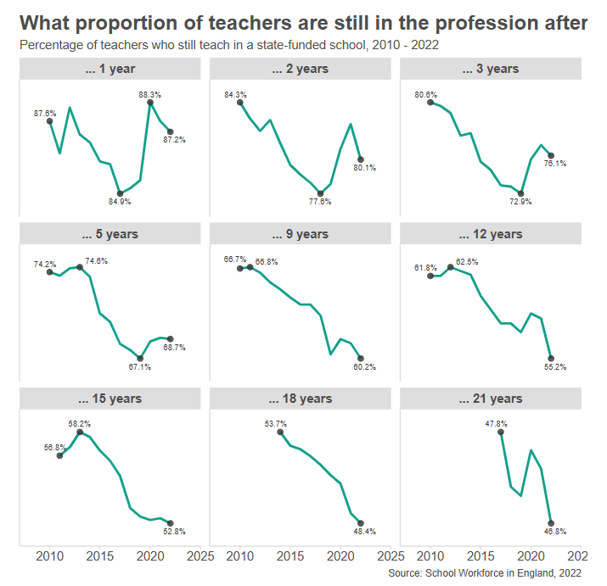
‘Six charts that explain the state of the teaching workforce in England’, 2023
epi.org.uk
Notes:
Number of teachers leaving in 2023 40,813 – 1700 fewer than in previous year. 41,736 entrants.

Slide 5
What can we do?
Make workload more manageable and predictable.
1
Address wellbeing strategically (not superficially).
2
Enable flexible working opportunities.
3
Invest in relationships with pupils and parents.
4
Provide opportunities for professional growth.
5
Notes:
There are practical things we can do! Small actions that build up and make a difference. Lots of it is interconnected; some subject to external forces that we can’t control. But there are things we can have influence over.

Slide 6
1. Make workload more manageable and predictable
High workload is one of the most cited reasons for teachers considering leaving the profession. Also:
Teachers’ perceptions of their workload remain much more negative than those of teachers who left the profession for other jobs, where around three-quarters of ex-teachers report having an ‘acceptable workload’ and ‘sufficient control over their workload’ in their new job.
Teacher top priorities for reducing workload: behaviour management and pastoral care; feedback and marking; lesson planning and preparation; pupil safeguarding and welfare.
Lesson planning is often viewed by teachers as both a key driver of workload and central to their professional identity as a teacher.
Sources
DfE: Working lives of teachers and leaders: wave 3
NFER: Teacher Labour Market in England Annual Report 2025
EEF: Recruiting, retaining and supporting teachers
Notes:
Other most commonly cited reason is stress or poor wellbeing – more on that shortly! More on behaviour to come too. Re lesson planning: quote shows how it’s not straightforward… Agency is important; staff want to be able to spend time on the things that they see making the most difference.
Workload is a hard one to shift; despite it being a policy focus in recent years and a slight improvement in terms of reported hours, it’s not a big change.

Slide 7
1. Make workload more manageable and predictable
Does your senior team plan and review key deadlines, spreading them evening throughout the year?
Are deadlines shared well in advance, so staff can plan?
Beware the casual "Can you just..." request. It might be the final straw!
Streamline wherever possible. Question processes. If something feels tedious or repetitive, there's likely a more efficient approach. Is someone actually using that data you’re collecting?
Use technology. Provide training so staff can use AI tools safely and effectively, e.g. for lesson planning, feedback, and administrative tasks.
Using ChatGPT can cut lesson planning by 31% - EEF study
Notes:
Mention the DfE AI training – available for free. And note from the EEF evidence summary: policy changes may not immediately reduce workload. In contrast, they often increase it in the short term as staff adapt to new ways of working. Give things time to bed in – you may not see the benefits until the following year.
Schools Week report: The group who used the service cut on average 25.3 minutes from their weekly year 7 and 8 lesson and resource planning time, compared to those who were asked not to use it, or any other generative AI tools.

Slide 8
2. Address wellbeing strategically (not superficially)
76% of staff are stressed (86% of senior leaders).
49% of education staff say their organisation’s culture negatively affects their mental health. Senior leaders report the highest levels of burnout, exhaustion and acute stress.
Most reported symptoms of poor mental health:
Insomnia or difficulty sleeping (50%)
Irritability or mood swings (45%)
Difficulty concentrating (41%)
Of staff considering leaving, 90% cited stress and/or poor wellbeing as a factor.
Sources
Teacher Wellbeing Index 2025
How do teachers feel about their working life?
Notes:
There are things we can control and things we can’t control. Helpful to recognise this! Lots of the current stressors are outside our sphere of influence e.g. lack of funding for social care and mental health services; Ofsted.

Slide 9
2. Address wellbeing strategically (not superficially)
Promote good sleep practices; talk about the importance of rest (seven types of rest).
Model healthy boundaries around evening emails and weekend work. Make sure staff know how to use email scheduling tools so that they only arrive during working hours.
Survey staff about their biggest stress sources; use the results to inform both wellbeing and workload strategies.
Consider conducting a stress risk assessment (see Education Support example approach).
Share and discuss resilience frameworks, such as the PERMA wellbeing framework.
Notes:
A fruit bowl and some yoga sessions isn’t going to fix it! Culture matters: got to mean it and live it. And yes it ties into workload – no point telling people to go home on time if you’re piling on the work pressure. If there is money to invest, maybe access to a helpline or counselling, or do some mental health first aid training. Recruitment research from Teacher Tapp found that health perks were attractive.

Slide 10
3. Enable flexible working opportunities
Fewer than half of education staff in England have flexible working arrangements, yet research suggests flexible working can boost recruitment, retention, wellbeing, and job satisfaction.
In the wider workforce, half of all graduates now work remotely.
‘The qualitative evidence is compelling: 82% of leaders at schools already offering it feel it has helped improve retention and most teachers (76%) believe that being able to work flexibly would encourage them to stay in the profession long-term.’ (EEF: Recruiting, Retaining and Supporting Teachers)
65% of staff wouldn't feel confident requesting flexible working, and 61% believe it would harm their career prospects.
Sources
NFER: Teacher Labour Market in England Annual Report 2025
DfE: Working lives of teachers and leaders: wave 3
Notes:
Disconnect between appetite for flexible working and fears of how it ‘looks’. Disconnect between teaching and other professions.

Slide 11
3. Flexible working opportunities in practice
Part-time working and job shares.
Phased retirement.
Varied hours e.g. term-time only, compressed or staggered hours.
Personal or family days/time.
Time in lieu for additional hours worked.
Home or remote working, e.g. PPA time conducted off site.
School case studies
DfE blog: Embracing flexible working in schools and trusts
Schools Week: Nine-day fortnight proves a big hit with Dixons staff
Notes:
Yes there are budget implications for some of this, e.g. part-time working. A temporary arrangement could be beneficial for staff members with a caring responsibility. The Dixons nine-day fortnight is interesting. It’s for teachers, not all staff, so potentially divisive. Would love to hear about other examples of flexible working. Both of the school case studies talk about money saved e.g. in recruitment fees or reduced staff absence.

Slide 12
3. Creating a flexible working culture
What’s your process for flexible working requests? Do you proactively offer options to all staff, or wait for individual requests?
Is there a belief that leadership requires a full-time presence? Do you have a culture that’s positive about flexible working? Is it modelled from the top?
Are teachers allowed to complete non-contact work when and where they’re most productive?
What are the flexible working opportunities that matter to your staff?
Do you have a flexible working policy in place?
Notes:
Mention policy template linked via download. Also: how about more flexibility to give staff time to pursue other interests? Professional opportunities? Ref Schools Week article linked on later slide.

Slide 13
4. Invest in relationships with pupils and parents
Pupil behaviour has become one of the fastest-growing contributors to teacher workload since the pandemic.
63% of staff reported increased incidents of challenging pupil behaviour, and 82% of those said it's damaged their mental health.
43% felt that vexatious parental complaints had increased.
Sources
NFER: Teacher Labour Market in England Annual Report 2025
Teacher Wellbeing Index 2024
Notes:
Parental complaints also a workload sucker.

Slide 14
4. Invest in relationships with pupils and parents
How are complaints being managed? Is that a time-sucker and cause of stress?
Acknowledge post-pandemic behaviour changes. Be proactive in fostering positive relationships as well as establishing clear, consistent expectations.
Create a school environment where everyone – pupils, families, and staff – genuinely wants to be.
Position parents as partners in learning, not problems to be managed.
Review your parental communication – is it clear, timely, succinct and positive?
Ensure staff feel fully supported by senior leaders when dealing with parent concerns.
Train staff in constructive conversation techniques for difficult discussions.
Notes:
This is a BIG issue, and don’t mean to suggest it can be easily solved. Two articles linked at end of the presentation. Links into stress management.

Slide 15

5. Provide opportunities for professional growth
‘Teachers who feel they are a “much worse teacher” than they were last year are THREE TIMES more likely to say they are going to leave teaching in the next three years.’ Teacher Tapp blog, 17 June 2025
‘In theory, there should be a link from participating in CPD to increased confidence and, in turn, to improved retention… However, teacher surveys suggest that teachers do not place a high value on the CPD that they currently experience, perhaps due to its lack of relevance to teachers’ current practice and personal development goals.’ NFER, How to recruit 6,500 teachers
Notes:
Caveats: teachers like external, funded CPD! Quality makes a big difference.

Slide 16
5. Provide opportunities for professional growth
Ask staff: what professional development would genuinely impact their practice? Can/does this fit with school development priorities?
Consider in-house mentoring, peer observation, action research projects, reading groups, collaborative projects and professional development frameworks.
Protect CPD time and allow space for practice and implementation – learning without application is wasted investment.
Better to do fewer things, in depth, or focus on just one thing.
Include all staff in development opportunities and make professional growth a regular discussion topic.
Notes:
Evidence-based, research-backed high quality CPD is what’s needed.

Slide 17
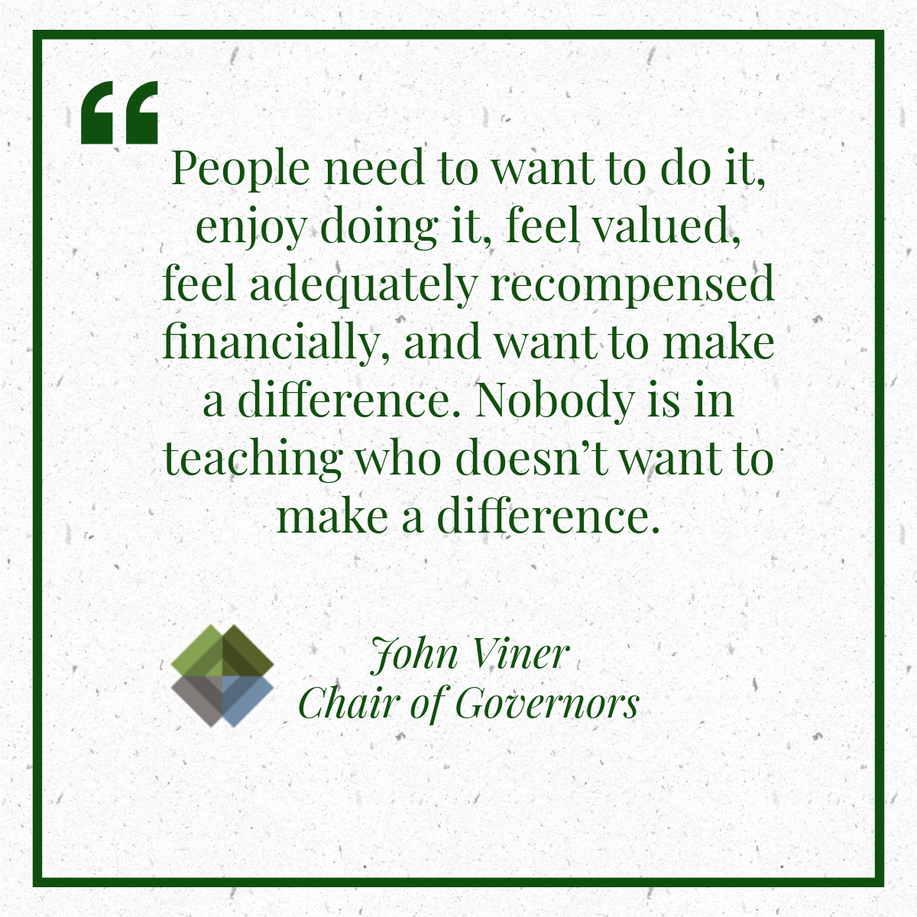
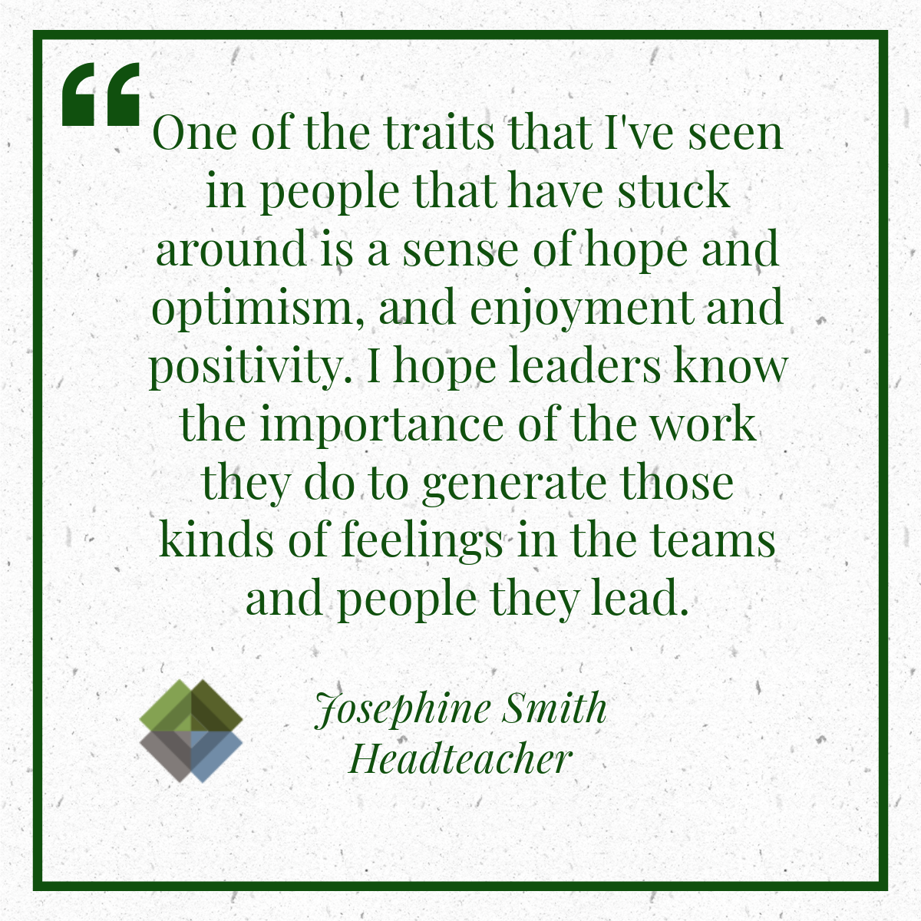
An experience-based view of staying power
Be kind: how to entice teachers and governors into our schools
Enjoy what you do: hope, joy and staying power
Notes:
Jo Smith – very interested in the notion of staying power, something she’s researching. Can also share the ‘counting the flowers’ strategy/approach: the importance of acknowledging the wins and what has worked.

Slide 18
More to explore
Evidence summary from the EEF: Recruiting, Retaining and Supporting Teachers
Blog and podcast: Avoiding and addressing staff burnout
Schools Week: An impoverished work-life drives too many teachers out
Need to Know:
How do we create a positive behaviour culture
Building positive parent partnerships
Education Leaders podcast: How to stop wasting your PD budget
EEF: Effective Professional Development
Download: Five evidence-based retention strategies

Slide 19



Stay in touch
Explore the website
Follow the podcast
Sign up to the newsletter
Email me: liz.worthen@createvalueschools.com
Notes:
On YouTube as well.

