Slide 1


AI, Students &
the Future of
Assessment
Moving beyond detection → towards learning, integrity, and clarity
Phil Peatling
Head of the Centre for Student Success
phpeatling@lincoln.ac.uk
Notes:
Let’s start with a truth that’s uncomfortable but useful: AI is not coming — it’s already here.
And it’s not just “students cheating”. It’s students learning, searching, drafting, planning, revising — inside an AI‑saturated digital environment.
So today I’m not going to do a fear talk. I’m going to do an honesty talk: if our assessment assumptions were built for a pre‑AI world, then the real risk isn’t AI…
The risk is we keep assessing the wrong thing.

Slide 2
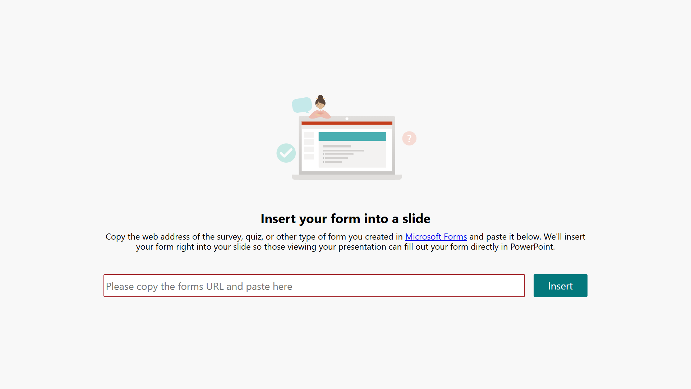



Slide 3
THE CHALLENGE
The Assessment –
It’s about designing assessment for the reality students are already in
Traditional assessments — essays, MCQs, problem sets — are no longer reliable indicators of individual learning when AI can produce them in seconds.
88%
3x
60%
of students used AI tools
for assessments in 2025
increase in confirmed
AI cheating cases (UK)
of grading time can be
reduced by AI tools
HEPI Survey, 2025
The Guardian, 2024
Curiously, 2026
AI is already shaping how students learn and prepare work
The real question: what do we assess now?
Notes:
Punchline: “We can’t future‑proof assessment by pretending the present isn’t happening.”

Slide 4
THE REALITY
How Students Actually Use AI
% of students using AI for each purpose
Not just cheating
Most students use AI as a learning support tool, not to bypass effort
Confidence gap
Only 5% of students feel confident using AI effectively for academic work
AI is embedded in how students:
  Learn
  Research
  Write
The issue is no longer if students use AI
The challenge: assessment hasn’t caught up
Grey zone
Only 26% view AI use in assessments as plagiarism — boundaries remain unclear

Slide 5

MINDSET SHIFT
The student reality:
AI is everywhere (even when they try not to use it)
AI is embedded in everyday study tools
Even writing platforms prompt AI support
Policies often assume AI is a choice — but the environment doesn’t.
“We wrote rules for a world where AI is optional. Students live in a world where AI is ambient.”
Notes:
Here’s the moment where policy meets reality. In internal discussion, I said it plainly: a student cannot avoid using AI in any assignment — because AI shows up inside the systems they’re required to use.
Library tools now include AI‑driven summarisation and discovery features; Word prompts AI actions; students are nudged towards AI by default.
So when we say “don’t use AI”, students hear:
“Do you mean don’t use ChatGPT?”
“Do you mean don’t use embedded features in the tools you gave me?”
That gap creates confusion — and confusion is where mistakes (and misconduct) thrive.

Slide 6
Policy
The policy experience:
confusion isn’t integrity, it’s anxiety
Students ask one question, again and again: “What’s allowed?”
Signposting is easily missed
Mixed messages create uncertainty
The policy is in every assignment brief and handbook
How do the staff pass on the message? The whole team on the same page?
Uncertainty drives fear… and sometimes bad decisions
“If students can’t interpret the rules, we’re not assessing integrity — we’re assessing guesswork.”
Transparency by all. This impacts both staff and students
Notes:
We’ve seen this in practice: even where policy exists, students don’t always pick it up — and colleagues have explicitly noted how easily AI policy messaging is missed.
So the student experience becomes:
different modules = different rules
staff confidence varies
students try to guess what the “safe” interpretation is
And what grows in that environment? Not integrity. Anxiety.
And anxious students don’t become careful ethical thinkers — they become risk‑avoiders.

Slide 7

Detection is not a reliable foundation
Detection isn’t a strategy
(and we’ve already admitted it)
AI detection tools aren’t dependable
The speed of developments the detection tools are never up to date
They won’t be used as sole evidence
When we have research that questions % of Ai use as being correct, it can’t be the only evidence
So… what are we building instead?
The same answer comes back – Assessment design si key
“If detection is shaky, design is our solid ground.”
Notes:
Here’s the crucial point: your own institutional draft policy language recognises that AI detection tools cannot reliably identify AI‑generated content and will not be used as sole evidence.
That’s not a minor detail. That’s the end of a strategy.
If detection can’t carry the weight… we stop building the entire system on it.
So what replaces it?
Not softer rules. Not harsher penalties.
Better assessment design + clearer expectations + teachable integrity.

Slide 8
Stop asking: “How do we stop AI?”
The shift: from ‘policing AI’ to ‘designing for learning’
Start asking: “What evidence of learning do we need?”
01
02
03
Assess judgement, not just output
Build integrity into the task
Make expectations visible and teachable
“AI isn’t breaking assessment. It’s revealing what assessment was already failing to measure.”
Redesign
Oral Components
Process‑based Tasks
Reflective Elements
Higher‑order Skills
Notes:
When AI can generate polished text, the “finished product” becomes less reliable as proof of learning.
So the centre of gravity shifts from product → process, from output → judgement.
Your policy direction already points toward redesign using authentic assessment, oral components, process‑based tasks, reflective elements, and higher‑order skills.
This is the moment to say something provocative to the room:
If our assessments can be completed by an AI with minimal understanding… then the assessment is telling us something.
It’s not telling us students are dishonest.
It’s telling us our task design is fragile.

Slide 9
Starting Point
Assessment Clarity –
A simple framework staff can use: RAG (Red / Amber / Green)
RED
AMBER
GREEN
No AI use in the assessment task
AI support is permitted in limited ways (optional; not for testing LOs)
AI is part of the learning outcome (with critical reflection + evidence)
“We don’t need one rule for everything.
We need one language students can understand.”
Notes:
This is where we move from philosophy to practice. The RAG model is already articulated in your institutional papers:
Red = no AI for the assessment (rare, but necessary in some contexts)
Amber = AI supported (optional), but cannot be used to meet the learning outcome being tested; requires explicit guidance and transparency
Green = students use AI as part of meeting learning outcomes, typically with reflection and evidence of use

Slide 10
Student Information
The missing piece: assessment briefs that reduce misconduct
If you want integrity, write for clarity
Closing the Gap
Every brief should state:
Which mode (R / A / G)
What tools are allowed (if any)
What AI can be used for (and what it can’t)
What students must declare
When students breach boundaries, it’s often because boundaries were invisible, inconsistent, or implied rather than stated.
“Clarity is a preventative strategy.”
Notes:
Your assessment policy work already emphasises that briefs should clearly identify the mode of AI use and provide clear guidelines on how AI can or cannot be used.
And you already have a usable “acceptable use” template structure: tool, expected use, limitations, acknowledgement.
Here’s the keynote point:
Punchline: “Clarity is a preventative strategy.”

Slide 11

MINDSET SHIFT
Transparency that students can do (declaration + referencing)
Make transparency normal, not scary
If AI is permitted: students declare use
Simple formula:
  Tool used
  What it was used for
  Where it influenced the work
“We don’t get honesty by making students terrified of being honest.”
Notes:
Student‑facing guidance already gives practical examples for how to reference AI use (including a simple format educators can point to).
Institutional guidance also stresses declaration of AI use as part of transparency and integrity
Here’s the provocative framing:
If we treat AI use as a “gotcha”, students hide it.
If we treat AI use as a literacy practice, students learn to disclose and critique it.
Punchline: “We don’t get honesty by making students terrified of being honest.”

Slide 12

Don’t ban AI - make students prove judgement
What ‘AI‑inclusive integrity’ looks like
Example assessment move:
Students use AI to generate an answer
Students then:
verify accuracy
identify errors/hallucinations
improve the response using discipline knowledge
reflect on what AI got wrong and why
“The goal isn’t ‘AI‑proof’ assessment. The goal is assessment that makes thinking unavoidable.”
Notes:
You have a powerful internal example from a transcribed meeting on AI assessment feedback:
the discussion highlights how AI‑generated answers were identified through invented cases and irrelevant research, and how the intention was to make students understand strengths and weaknesses rather than simply produce text.
That is the pivot: we assess what humans do best — verification, reasoning, disciplinary judgement.

Slide 13
The future of assessment isn’t anti‑AI. It’s pro‑learning.
1
Stop centering detection
“The question isn’t whether students will use AI. The question is whether our assessment still measures what matters.”
2
Start centering : judgement
3
Start centering : process
4
Start centering : transparency
5
Start centering : inclusion
Give students one clear message: learn it, use it ethically, show your thinking
Notes:
AI will keep changing. That’s not the interesting part.
The interesting part is what we do next.
We can build an assessment culture that:
treats students like risks to manage, or
treats students like learners to develop
Your institutional policy direction already supports AI as enhancing learning while maintaining integrity, and emphasises human oversight and clear guidance.

Slide 14

In a world of AI your freedom is in your unpredictability.
Large language models trained to do the most predictable thing next.
The most meaningful of things to us, are often not predictable.
https://www.instagram.com/reel/DW7KHlQjDYn/

